Slide 1
Video photo booth rental Beverly Hills
https://www.luckyfrogphotos.com/beverly-hills-360-photo-booth-rental.html
Notes:
https://www.luckyfrogphotos.com/beverly-hills-360-photo-booth-rental.html
https://drive.google.com/drive/folders/1JBURcxZVsyjgWc4IWOMVylmNb5vxsWe0?usp=sharing
https://news.google.com/rss/search?q=videobooth
https://drive.google.com/drive/folders/1rCry2TxXXZ7IwJTboR_8g7buFEdNTm2k?usp=sharing
https://drive.google.com/drive/folders/1XwxlTsfDVqZv-cKz6C3MF5iD89Qzj-yT?usp=sharing
https://drive.google.com/drive/folders/1A5-04QrJgTYlFFdI-nuEMg68qhy-BnkY?usp=sharing
https://drive.google.com/drive/folders/1m7DyLlFlbzk6gv3QQFUj7cbltzva6E-b?usp=sharing
https://drive.google.com/file/d/1Ydn2hOARUOVW_ahaGWH18ardfWICigtD/view?usp=sharing
https://drive.google.com/file/d/1ayjHHqtlfMo253xtM38PBtQN2XxSNWul/view?usp=sharing
https://drive.google.com/file/d/1JZWf6iRGOYJUmbWIzTGJ2-7oNXzWeeBu/view?usp=sharing
https://drive.google.com/file/d/1qp2QQ2vcWsVa4PClkqmVzWQZUmuxIjup/view?usp=sharing
https://drive.google.com/file/d/1oqwHP2Lvo6amJ_figUE0BV0xvu8LELY7/view?usp=sharing
https://drive.google.com/file/d/1kC3ej4BMpxiLcau-R539MYfDKxCbw2ay/view?usp=sharing
https://docs.google.com/spreadsheets/d/1ec-qHftUFW6UBAQ8fzkSQJh_fB9OTFrjgesgUJ9MItc/edit?usp=sharing
https://docs.google.com/spreadsheet/pub?key=1ec-qHftUFW6UBAQ8fzkSQJh_fB9OTFrjgesgUJ9MItc
https://docs.google.com/spreadsheets/d/1ec-qHftUFW6UBAQ8fzkSQJh_fB9OTFrjgesgUJ9MItc/pubhtml
https://docs.google.com/spreadsheets/d/1ec-qHftUFW6UBAQ8fzkSQJh_fB9OTFrjgesgUJ9MItc/pub
https://docs.google.com/spreadsheets/d/1ec-qHftUFW6UBAQ8fzkSQJh_fB9OTFrjgesgUJ9MItc/view
https://docs.google.com/forms/d/1JBj9fs3nYtGyk-EMLrh3kB4Rv3XVcb4emvCnW9lEFJM/edit?usp=sharing
https://docs.google.com/drawings/d/1oTDneliB4tQexl0F_0pfIW6LZBVXEfObnfCIwPfi3T4/edit?usp=sharing
https://drive.google.com/file/d/1Ub_baxN1yIKa7z6PHbWKiQ5Hv3QmkYdb/view?usp=drivesdk
https://sites.google.com/view/lagunabeachphotoboothrentals/home
https://docs.google.com/document/d/1s6hvB6vGpdun_ZY_lRZSFEAnE2DEeP5KWeyrGU0RNdg/edit?usp=sharing
https://docs.google.com/document/d/1s6hvB6vGpdun_ZY_lRZSFEAnE2DEeP5KWeyrGU0RNdg/pub
https://docs.google.com/document/d/1s6hvB6vGpdun_ZY_lRZSFEAnE2DEeP5KWeyrGU0RNdg/view
https://docs.google.com/presentation/d/1WSzezglxtVDEFl2hX-vNCG9NCdoOcyy89RdP_wQdCJQ/edit?usp=sharing
https://docs.google.com/presentation/d/1WSzezglxtVDEFl2hX-vNCG9NCdoOcyy89RdP_wQdCJQ/pub?start=true&loop=true&delayms=3000
https://docs.google.com/presentation/d/1WSzezglxtVDEFl2hX-vNCG9NCdoOcyy89RdP_wQdCJQ/view
https://docs.google.com/presentation/d/1WSzezglxtVDEFl2hX-vNCG9NCdoOcyy89RdP_wQdCJQ/htmlpresent

Slide 2
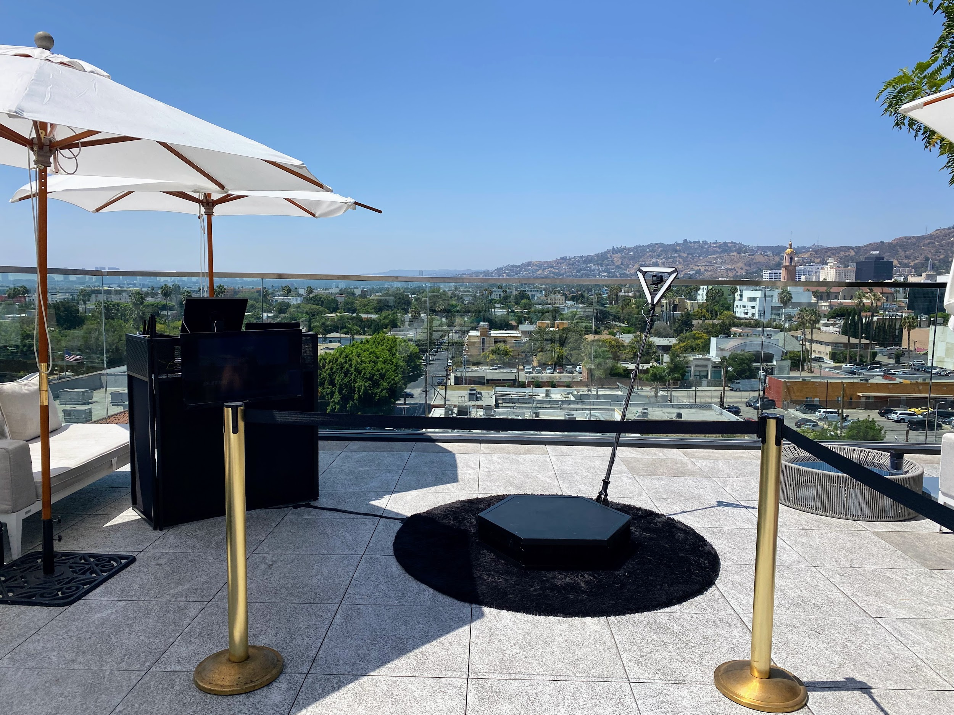

Slide 3
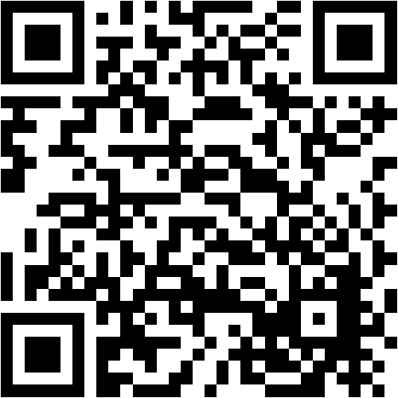

Slide 4
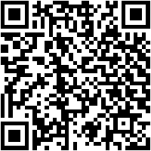
Video photo booth rental Beverly Hills
Vogue Photo Booths rents out photo booths for weddings, corporate events, instructor activities, private parties, and much more. Our photo booths are mobile, fashionable, and smart. We supply endless high answer photographs for your visitors, tailored like your selection of custom logo. We moreover pay for online photo galleries, fascinating props, memory books, and supplementary services to encourage create your event really memorable. Those amusing images will be shared once friends, uploaded on Facebook and Instagram, and displayed on refrigerators and office desks to be viewed repeatedly. Those guest prints, personalized gone your names and dates for your wedding or event, will along with continue to remind your guests long after your date how much fun your concern essentially was for years&nbsp;It's a full of life tunnel once pulsating well-ventilated tubes lining the walls. This enclosure is agreed versatile and may be used subsequently any of the way in air photo booths as with ease as slo-mo video. run by the side of the runway. taking into account this stunning image maker, you can be the greatest in town. Pose for the camera once our vivacious Tunnel Vogue Photo Booth Rental. get a Photo print and video emailed. During your session, you can listen to music even if you pose and record. 6ft x 8ft booth when integrated LED lights Simple-to-use kiosk like video/print/email capabilities. Branding upon prints and video. all photo bears your logo/message! Booth host to back you in the manner of presidency the runway. {} Vogue Photo Booth offers the protest to your yellow County area wedding, special event, or corporate event! pick from our astonishing backgrounds, snarky props, filters, and more to help your guests have fun and invade the moment! complement the attraction of a photo shoot subsequent to the fun of a photo booth, and thats what you get past you employ a Vogue Photo Booth! We have speech bubbles, hashtag props, themed props, well-liked words, you make known it! If you in fact want to go all out, we can make custom props in your favorite colors and themes! Whether they want to reveal it on IG, portion upon Facebook, email or text it, your guests can instantly part videos. This isn't your grandmother's photo booth. Our digital-first booths have no walls, ceilings, film, or ceilings, and there is no limit to what we can make together! Sequins! Walls of greenery! Colors that pop! whatever backdrop you require, we are distinct to have it. We may after that design unique backdrops to settle your theme or to put the accent on your business. View our selection by clicking here. Photo Booth offers premium admittance concept photo booth rentals throughout the Dallas&nbsp;OC Metropolis area. Our kiosk-style booths feature DSLR cameras, strobe lighting that surrounds you in soft, charming light, and ultra-fast dye-sublimation printers. We along with use cutting-edge technology, allowing you to offer your guests taking into consideration all of the hottest photo trends sweeping social media. Packed full next experiences such as GIFs, Boomerangs, TicTok style videos, Digital Props and more, your guests will have a blast! Not unaccompanied are they clever to choose their experience, they tersely get the output to easily share with the world. Our digital booths are ultra-modern and user-friendly, eliminating the need for an attendant. It is ideal for undertakings in compact areas such as offices, trade comport yourself booths, restaurants, or anywhere else where room is limited!
Our digital booths are ideal for actions such as festivals, grand openings, trade shows, conferences, product launches, brand activations, restaurants, corporate events, and multi-day rentals. Our fascinating all digital selfie booths will keep your guests entertained as they acknowledge selfies. You'll adore the radiance that comes from its small footprint and elegant design. subsequent to you enter our digital booth, practice your poses or acquire ready to bust a dance. Gifs and boomerangs are quite popular! Your guest will have a good time and will have something cold to pronounce upon social media! Digital SnapChat props and unique filters following the black and white and glam filters used by the Kardashians grow to the enjoyment. Have any moves? with amazing effects, a personalized overlay, and hot music, upgrading your digital booth rental to a TikTok Video Booth is the ideal choice for your visitors to act out off their skills while ensuring the fun!! GIFs are popular on Instagram. Facebook just supplementary the capability to pronounce GIFs via connections from additional websites, but Instagram has not. Our Roamer Booth, afterward our Digital Booths, is jam-packed in imitation of experiences in imitation of GIFs, Boomerangs, Digital Props, and more, but it's upon the move! There will be no more waiting in descent for your guests. Our Roamer Photo Booth will accompany them! Our proficient attendant ensures that we make a purchase of astounding shots of everyone and that we can commandeer the fun anywhere. Our Roamer Booths are ideal for use at festivals, sporting events, walk/run events, grand openings, trade shows, conferences, product launches, brand activations, restaurants, and corporate events.&nbsp;When you enter our digtal booth, practice your poses or get ready to bust a dance. Gifs and boomerangs are quite popular! Your guest will have a good era and will have something cool to say on social media! Digital "SnapChat"-style props and unique filters next the black and white and glam filters used by the Kardashians amass to the enjoyment. GIFs are popular on Instagram. Facebook just extra the capability to reveal GIFs via associates from extra websites, but Instagram hasn't been cooperating at all. That's OK. We have the tools to put up to your guests in posting their GIFs on every three of these social media platforms. let the Likes, Shares, and Retweets begin!
https://www.luckyfrogphotos.com/beverly-hills-360-photo-booth-rental.html
Notes:
Video photo booth rental Beverly Hills

Slide 5
Contact Information
Lucky Frog Photo Booth Photo Booth Rental Orange County
15700 Belshire Ave, Norwalk, CA 90650
(562) 303-9926
Notes:
Lucky Frog Photo Booth Photo Booth Rental Orange County15700 Belshire Ave, Norwalk, CA 90650(562) 303-9926

Slide 6
More info about us:
Video photo booth rental Beverly Hills
Notes:
Lucky Frog Photo Booth Photo Booth Rental Orange County15700 Belshire Ave, Norwalk, CA 90650(562) 303-9926

Slide 7
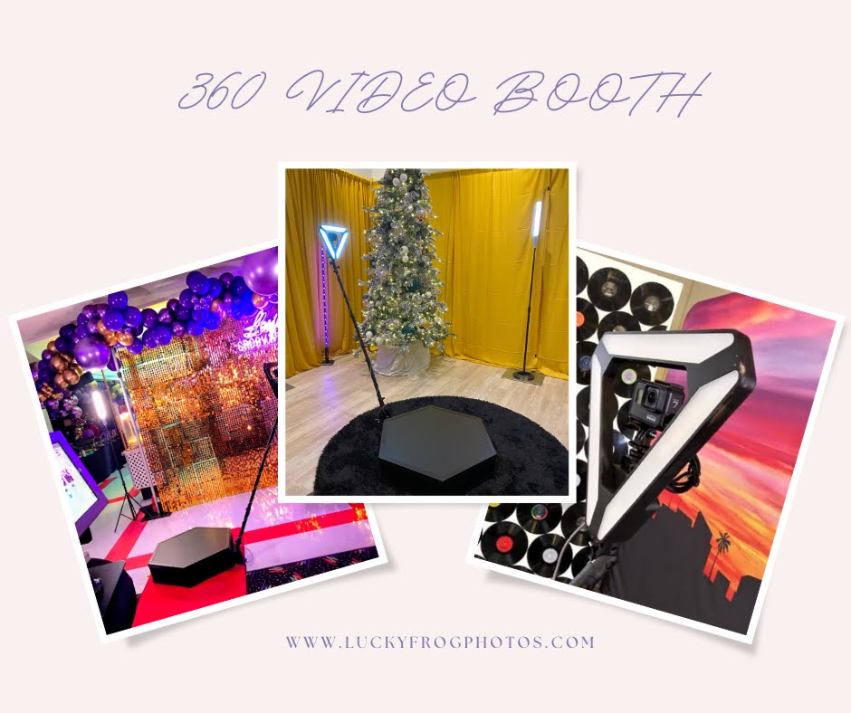

Slide 8
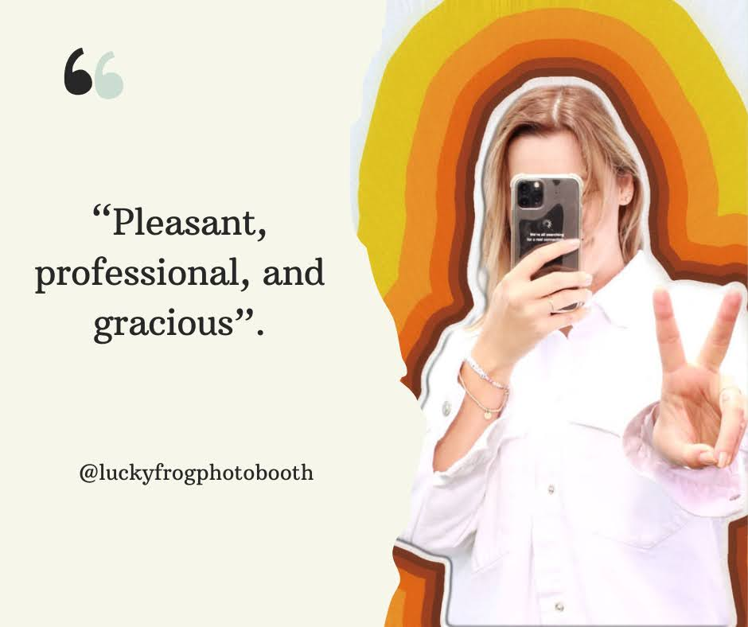

Slide 9
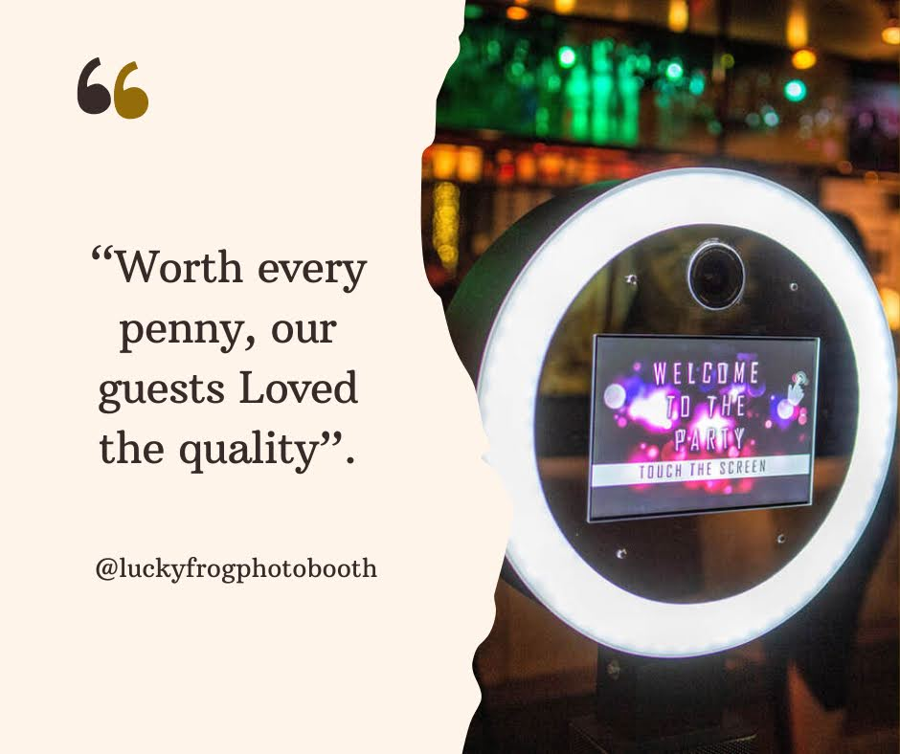

Slide 10
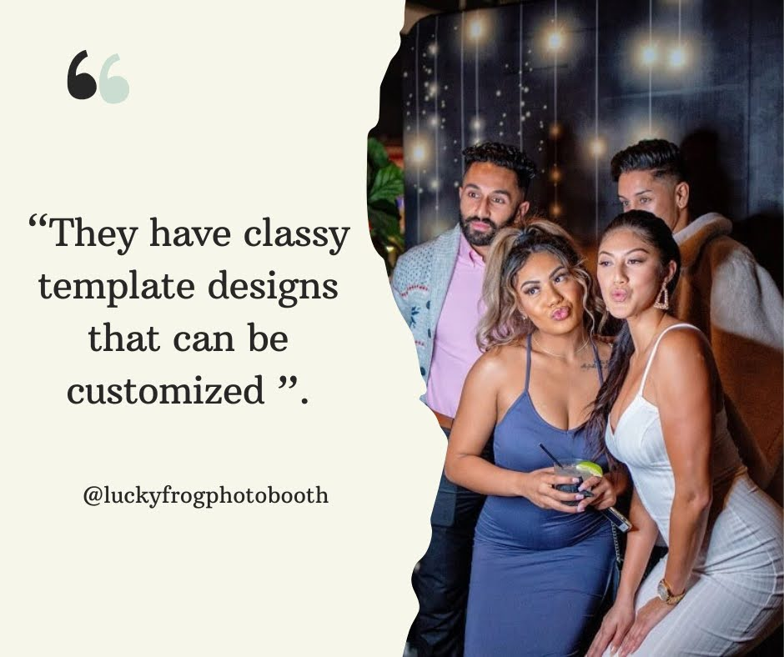

Slide 11
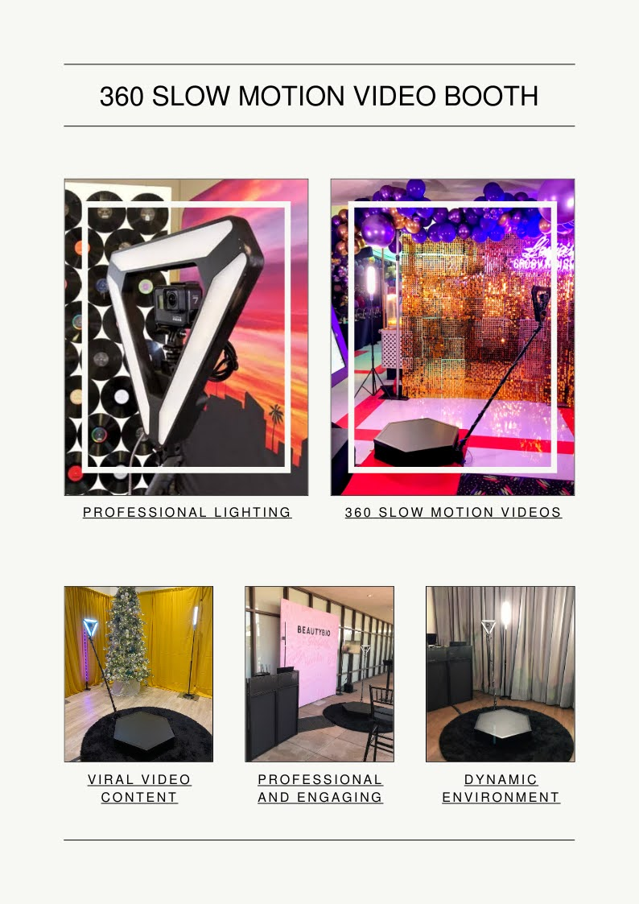

Slide 12
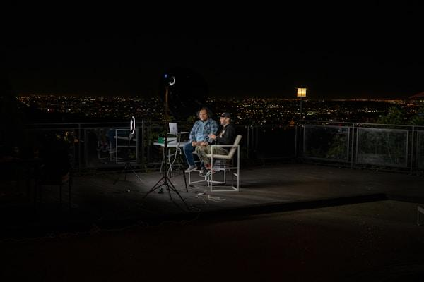

Slide 13
Links
List of recommended resources
Notes:
Video photo booth rental Beverly Hills

Slide 14
Please visit :
target url
folder top
rss feed
folder articles
folder photos
folder pdfs
folder slides
photo
photo
photo
photo
photo
photo
spreadsheet
spreadsheet key
spreadsheet pubhtml
spreadsheet pub
spreadsheet view
form
drawing
image
image link
document
document pub
document view
presentation
presentation pub
presentation view
presentation html

Slide 15
Videos
YouTube videos we recommend watching!
Notes:
Video photo booth rental Beverly Hills

Slide 16
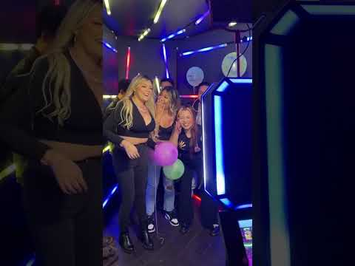
https://www.luckyfrogphotos.com/beverly-hills-360-photo-booth-rental.html

Slide 17

https://www.luckyfrogphotos.com/beverly-hills-360-photo-booth-rental.html

Slide 18
https://www.luckyfrogphotos.com/beverly-hills-360-photo-booth-rental.html

Slide 19

https://www.luckyfrogphotos.com/beverly-hills-360-photo-booth-rental.html

Slide 20
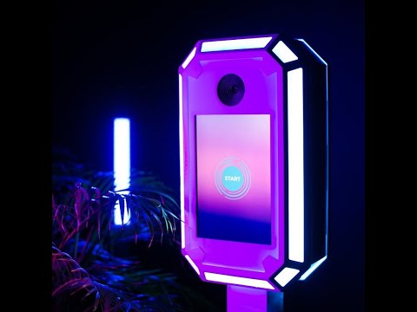
https://www.luckyfrogphotos.com/beverly-hills-360-photo-booth-rental.html
Notes:
https://www.luckyfrogphotos.com/beverly-hills-360-photo-booth-rental.html
https://drive.google.com/drive/folders/1JBURcxZVsyjgWc4IWOMVylmNb5vxsWe0?usp=sharing
https://news.google.com/rss/search?q=videobooth
https://drive.google.com/drive/folders/1rCry2TxXXZ7IwJTboR_8g7buFEdNTm2k?usp=sharing
https://drive.google.com/drive/folders/1XwxlTsfDVqZv-cKz6C3MF5iD89Qzj-yT?usp=sharing
https://drive.google.com/drive/folders/1A5-04QrJgTYlFFdI-nuEMg68qhy-BnkY?usp=sharing
https://drive.google.com/drive/folders/1m7DyLlFlbzk6gv3QQFUj7cbltzva6E-b?usp=sharing
https://drive.google.com/file/d/1Ydn2hOARUOVW_ahaGWH18ardfWICigtD/view?usp=sharing
https://drive.google.com/file/d/1ayjHHqtlfMo253xtM38PBtQN2XxSNWul/view?usp=sharing
https://drive.google.com/file/d/1JZWf6iRGOYJUmbWIzTGJ2-7oNXzWeeBu/view?usp=sharing
https://drive.google.com/file/d/1qp2QQ2vcWsVa4PClkqmVzWQZUmuxIjup/view?usp=sharing
https://drive.google.com/file/d/1oqwHP2Lvo6amJ_figUE0BV0xvu8LELY7/view?usp=sharing
https://drive.google.com/file/d/1kC3ej4BMpxiLcau-R539MYfDKxCbw2ay/view?usp=sharing
https://docs.google.com/spreadsheets/d/1ec-qHftUFW6UBAQ8fzkSQJh_fB9OTFrjgesgUJ9MItc/edit?usp=sharing
https://docs.google.com/spreadsheet/pub?key=1ec-qHftUFW6UBAQ8fzkSQJh_fB9OTFrjgesgUJ9MItc
https://docs.google.com/spreadsheets/d/1ec-qHftUFW6UBAQ8fzkSQJh_fB9OTFrjgesgUJ9MItc/pubhtml
https://docs.google.com/spreadsheets/d/1ec-qHftUFW6UBAQ8fzkSQJh_fB9OTFrjgesgUJ9MItc/pub
https://docs.google.com/spreadsheets/d/1ec-qHftUFW6UBAQ8fzkSQJh_fB9OTFrjgesgUJ9MItc/view
https://docs.google.com/forms/d/1JBj9fs3nYtGyk-EMLrh3kB4Rv3XVcb4emvCnW9lEFJM/edit?usp=sharing
https://docs.google.com/drawings/d/1oTDneliB4tQexl0F_0pfIW6LZBVXEfObnfCIwPfi3T4/edit?usp=sharing
https://drive.google.com/file/d/1Ub_baxN1yIKa7z6PHbWKiQ5Hv3QmkYdb/view?usp=drivesdk
https://sites.google.com/view/lagunabeachphotoboothrentals/home
https://docs.google.com/document/d/1s6hvB6vGpdun_ZY_lRZSFEAnE2DEeP5KWeyrGU0RNdg/edit?usp=sharing
https://docs.google.com/document/d/1s6hvB6vGpdun_ZY_lRZSFEAnE2DEeP5KWeyrGU0RNdg/pub
https://docs.google.com/document/d/1s6hvB6vGpdun_ZY_lRZSFEAnE2DEeP5KWeyrGU0RNdg/view
https://docs.google.com/presentation/d/1WSzezglxtVDEFl2hX-vNCG9NCdoOcyy89RdP_wQdCJQ/edit?usp=sharing
https://docs.google.com/presentation/d/1WSzezglxtVDEFl2hX-vNCG9NCdoOcyy89RdP_wQdCJQ/pub?start=true&loop=true&delayms=3000
https://docs.google.com/presentation/d/1WSzezglxtVDEFl2hX-vNCG9NCdoOcyy89RdP_wQdCJQ/view
https://docs.google.com/presentation/d/1WSzezglxtVDEFl2hX-vNCG9NCdoOcyy89RdP_wQdCJQ/htmlpresent

Slide 21
Video photo booth rental Beverly Hills
https://www.luckyfrogphotos.com/beverly-hills-360-photo-booth-rental.html
Notes:
Video photo booth rental Beverly Hills

